Slide 1
Record of Contacts
Kelly Divine
District 3 Right of Way Supervisor

Slide 3
proper techniques & good practices
Timely Entries – Contacts should be recorded the day of the appointment or the following day if possible.
RWUMS – If contacts are typed into a Word document, they must be cut and pasted immediately into RWUMS for information sharing purposes. Do not keep ROCs on personal computer.

Slide 4
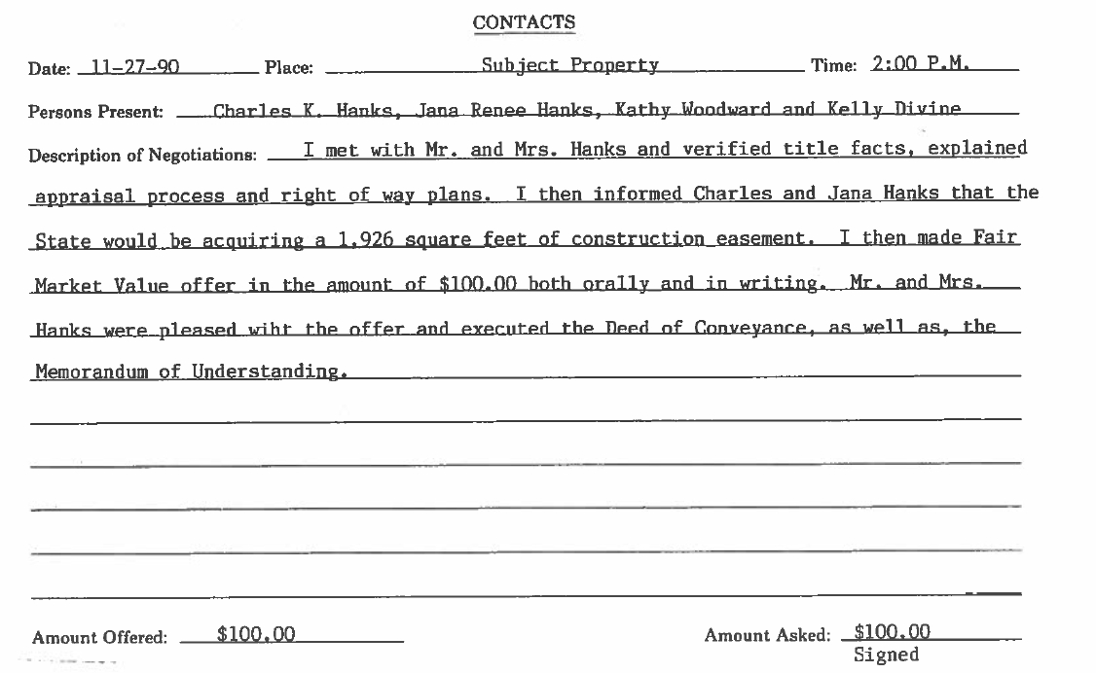

Slide 5
Verify title facts with property owners
Review ownership & verify whether or not encumbrances are still active. Explain their possible involvement in obtaining the necessary releases.
State employees
Inquire if the owner(s) are state employees.
SSN / FIN
Ask owner to provide Social Security Number or Federal ID Number. Try to obtain this information on initial contact if possible. Negotiations may reach an impasse and this information may become difficult to obtain.

Slide 6
Explain the proposed acquisition
Explain the specific area amounts to be acquired and type (i.e. Fee Simple, Permanent Easement, Temporary Easement) and for what purpose.
Describe the color codes on the plans.
Explain the type of facility to be constructed (i.e. 2 lanes, 3 lanes, 3 lanes with truck climbing lanes, 4 lanes, curb & gutter, sidewalks, etc.).
What is the purpose of the project?
What structures or site improvements are to be acquired, if any. If owner decides to retain any of the improvements, document which ones and their salvage values. Explain the processes involved in retaining and moving an improvement. Explain their responsibilities in replacing fencing or access, and how they were compensated in the appraisal report.

Slide 7
Explain the proposed acquisition
Describe the severances, if any.
Provide dimensions of the acquisition and explain proximities to the improvements, if any. Is the travelway moving closer or further away?
Describe proposed slope elevations, including entrances. Review the cross sections with the property owner.
Describe entrances: width, location, and type of surface.
In Minor Acquisition Reviews (MARs), provide explanation of the process, calculation, and Range of Values.
Explain the appraisal process if applicable. Direct owners to Sheets 10 & 16 of the appraisal report (narrative and recapitulation sheets).
Describe only the pertinent details of the conversation.

Slide 8
Present the Fair Market Value Offer
Present the offer both VERBALLY and IN WRITING
Document the amounts and if multiple offers are made (i.e. uneconomic remainders)

Slide 9
Ask owners if they have any questions
Document their question(s) and provide specific answers to each question asked. Do not make up answers. If you do not know the answer, state so and secure the answer from the appropriate individuals.
Review documents to be executed
Deed of Conveyance/Grant of Easement
Contract for Deed
Memorandum of Understanding
Corporate Resolution
Consent & Release

Slide 10
Document which items are provided to the owner(s)
Business card
Copy of the colored plan sheets
Appraisal report / MAR calculation
Do not “horse trade”
The Cabinet makes ONE offer, the FMV Offer.
All counter offers are provided by the owner(s).
Document all concessions mutually agreed upon
Make sure those items are also included on Page 2 of the MOU. It is recommended to consult with Design, Utilities, Environmental, & possibly Construction prior to any concessions.

Slide 11
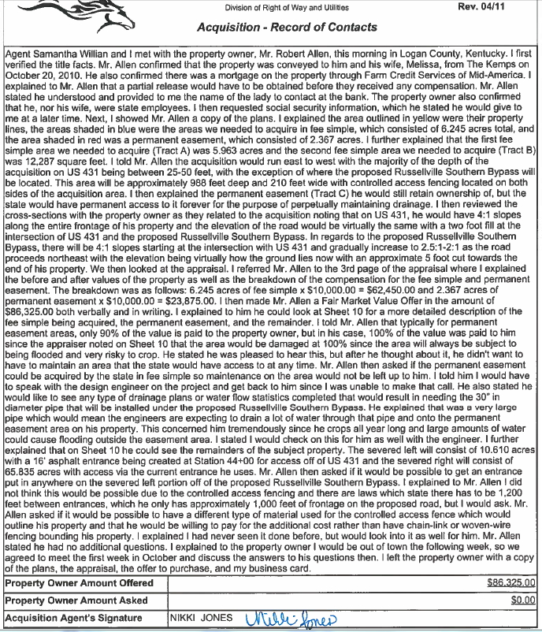
C

Slide 12
Document unsuccessful attempts to reach a property owner
Write as 1 contact
Document a time frame for a follow-up contact
Approximately 7-10 days

Slide 13
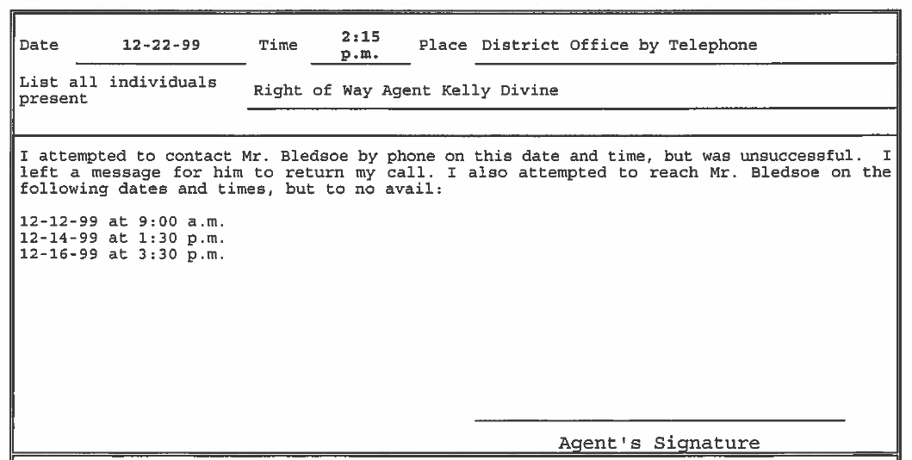

Slide 14
To summarize:
BE PREPARED – Do the proper research PRIOR to making the FMV offer
Know the purpose of the project, specifics of the acquisition, study the appraisal report/plans/cross sections, know the clearance/letting dates, etc.
Take ownership of each assigned parcel. Don’t be a messenger.
Document ALL pertinent information discussed during each contact.

Slide 15
Agent’s Role/responsibility
The acquisition agent’s responsibility is to explain the proposed acquisition and highway project thoroughly, as well as answer all questions and concerns so the property owner can make an informed decision. NO SURPRISES!

Slide 16
Helpful Suggestions
Avoid making the FMV offer over the phone
Obtain/verify owner information while making the initial contact
Be an active listener
Be honest, polite, and firm
Don’t mention counter offer
If all questions/concerns are answered during initial contact, lead to the closing

